Slide 1


Tymoshenko Mykyta
2025-25-12

Slide 2

Outline
Executive Summary
Introduction
Methodology
Results
Conclusion
Appendix

Slide 3
Executive Summary
METHODOLOGY | RESULTS
Data Collection: Combined API retrieval with web scraping | Cleaned dataset ready for analysis
Data Wrangling: Cleaning, transforming, and merging datasets | Structured data enabled accurate insights
Exploratory Data Analysis (EDA): SQL queries and visualizations | Key trends and patterns identified
Dashboard Development: Interactive dashboards with Plotly & Folium | Interactive charts and maps for easy data exploration
Predictive Analysis: Classification modeling | Model achieved with 83% accuracy

Slide 4
Introduction
Context:
SpaceX reduces launch costs by reusing the Falcon 9 first stage
First stage recovery is key to determining launch cost
As a data scientist at Space Y, I tasked with analyzing SpaceX data
Problems to Solve:
Which attributes influence first stage landing success? (e.g., launch site, payload mass, launch number)
Can we predict first stage recovery using machine learning?
How do combinations of features improve prediction accuracy?

Slide 5

Section 1

Slide 6
Methodology
Executive Summary
Data collection methodology:
Combined API data retrieval with web scraping
Perform data wrangling
Cleaning, transforming, and merging datasets
Perform exploratory data analysis (EDA) using visualization and SQL
Perform interactive visual analytics using Folium and Plotly Dash
Perform predictive analysis using classification models
Building, tuning, and evaluating classification models

Slide 7
Data Collection
• API Retrieval & Normalization
Collecting SpaceX launch data via GET requests to the REST API and converting the resulting JSON objects into a flat dataframe using json_normalize
• Targeted Data Enrichment
Using specific identification numbers from the initial data to target other API endpoints for detailed information on boosters, launchpads, payloads, and cores,.
• Web Scraping
Utilizing the BeautifulSoup package to extract additional Falcon 9 records from Wikipedia HTML tables for further analysis,.
• Filtering & Cleaning
Refining the dataset by removing Falcon 1 launches and handling missing values by replacing null PayloadMass entries with the calculated mean.

Slide 8
Data Wrangling
Attribute Analysis
Reviewing key variables such as Flight Number, Payload Mass, Orbit, and Launch Site to understand the launch environment and specifications.
• Data Filtering & Imputation
Removing Falcon 1 records to isolate Falcon 9 data and replacing missing PayloadMass values with the calculated mean of the column.
• Outcome Classification
Analyzing the eight different landing statuses (like "True ASDS" or "False ASDS") to determine the success of the first stage.
• Binary Labeling
Converting these landing outcomes into a classification variable "Y", where 1 represents a successful landing and 0 represents a failure.
• Handling Structural Nulls
Maintaining null values in the LandingPad column—since they signify a landing pad was not used—for later processing via one-hot encoding.

Slide 9
EDA with Data Visualization
• Trend Identification
Visualizing data over time reveals that the success rate has improved since 2013, highlighting "Launch Number" as a key feature for predictive modeling.
• Site-Specific Performance
Comparison shows that different launch sites have varying success rates; for instance, CCAFS LC-40 has a 60% success rate, while KSC LC-39A and VAFB SLC 4E both average around 77%.
• Feature Interaction
By overlaying landing outcomes as colors on plots, you can see how combined attributes affect success, such as noticing that payloads over 10,000 kg at CCAFS LC-40 have a 100% success rate.
• Correlation and Preparation
The process focuses on determining which attributes are correlated with successful landings and preparing categorical variables for machine learning using one-hot encoding.

Slide 10
EDA with SQL
• Launch Site Evaluation
Querying the database to identify unique launch sites (CCAFS LC-40, KSC LC-39A, and VAFB SLC 4E) and calculating their individual success rates—such as the 60% success rate at CCAFS LC-40.
• Mission Outcome Analysis
Retrieving and filtering the eight different landing outcomes (such as "True ASDS" or "False ASDS") to determine which launches were successful.
• Payload and Orbit Correlation
Analyzing the relationship between Payload Mass and different Orbits (like LEO and GTO) to see how they affect landing outcomes.
• Success Rate Trends
Extracting data to show that the overall success rate has improved since 2013, which allows the "Launch Number" to be used as a predictive feature.
• Statistical Calculations
Using database functions to calculate the mean PayloadMass, which is necessary for filling null values to make the dataset viable for analysis.

Slide 11
Build an Interactive Map with Folium
Geospatial Marking
Plotting the specific longitude and latitude of launch sites, such as Vandenberg AFB, Kennedy Space Center, and CCAFS SLC 40, onto an interactive map.
• Proximity Analysis
Identifying and marking close proximities near launch sites to visualize their surrounding environments and geographic constraints.
• Interactive Exploration
Utilizing tools like zoom-in/out, pan, and search to find visual patterns faster and more effectively than with traditional static graphs.
• Site Optimization
Evaluating the geographic data and markers to discover patterns that explain how to choose an optimal launch site

Slide 12
Build a Dashboard with Plotly Dash
Build a dashboard application using the Python Plotly Dash package to present data stories more effectively than static graphs.
• Incorporate interactive input components, such as a dropdown list and a range slider, to allow users to manipulate and filter the data in real-time.
• Generate dynamic visual outputs, specifically a pie chart and a scatter point chart, to display specific insights from the SpaceX dataset.
• Enable advanced interactions like filtering and searching to help users find visual patterns and insights faster and more effectively

Slide 13
Predictive Analysis (Classification)
• Data Preprocessing and Splitting
Standardizing the data and performing a train_test_split to separate the dataset into training and testing portions.
• Hyperparameter Optimization
Utilizing Grid Search to find the best hyperparameter values, ensuring each chosen algorithm performs at its peak.
• Algorithm Comparison
Testing four distinct classification models to find the most effective predictor: Logistic Regression, Support Vector Machines (SVM), Decision Tree Classifier, and K-nearest neighbors (KNN).
• Performance Evaluation
Selecting the model with the best accuracy on the training data and generating a confusion matrix to visualize the final results.

Slide 14

Section 2

Slide 15
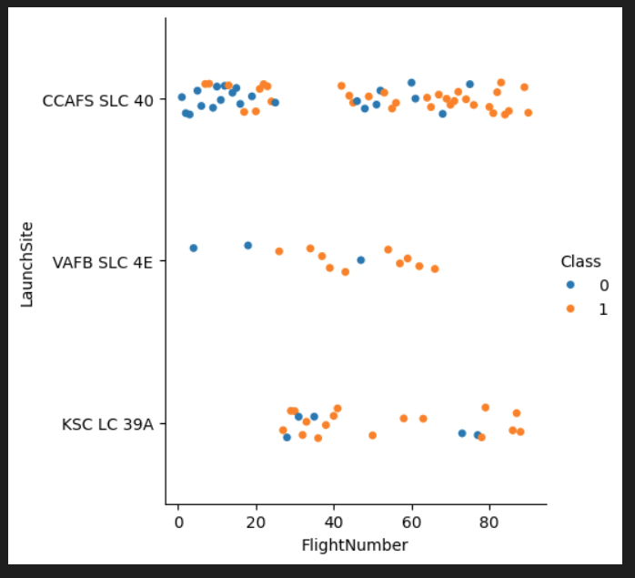
Flight Number vs. Launch Site

Slide 16
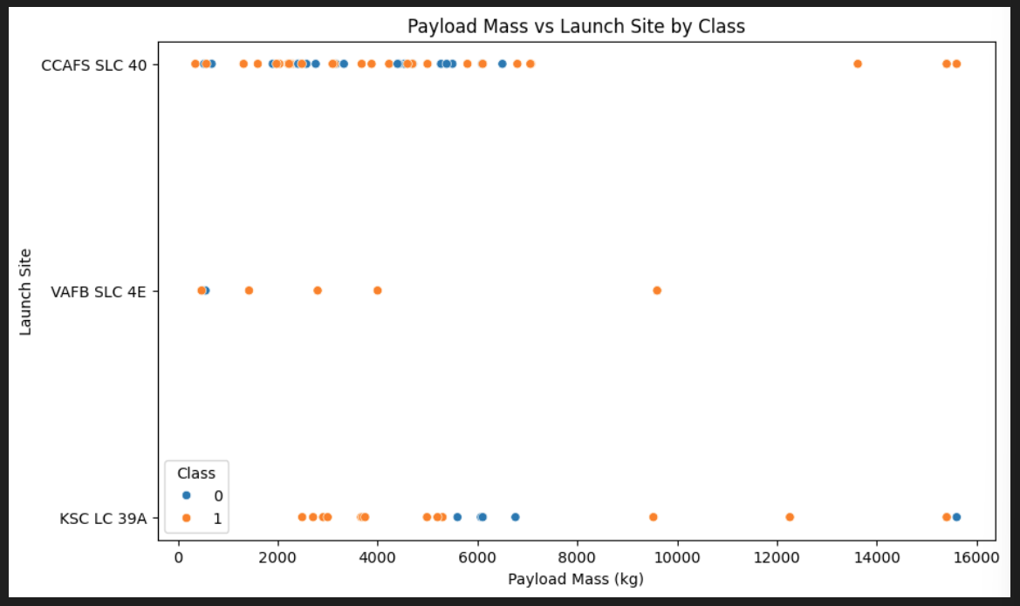
Payload vs. Launch Site

Slide 17
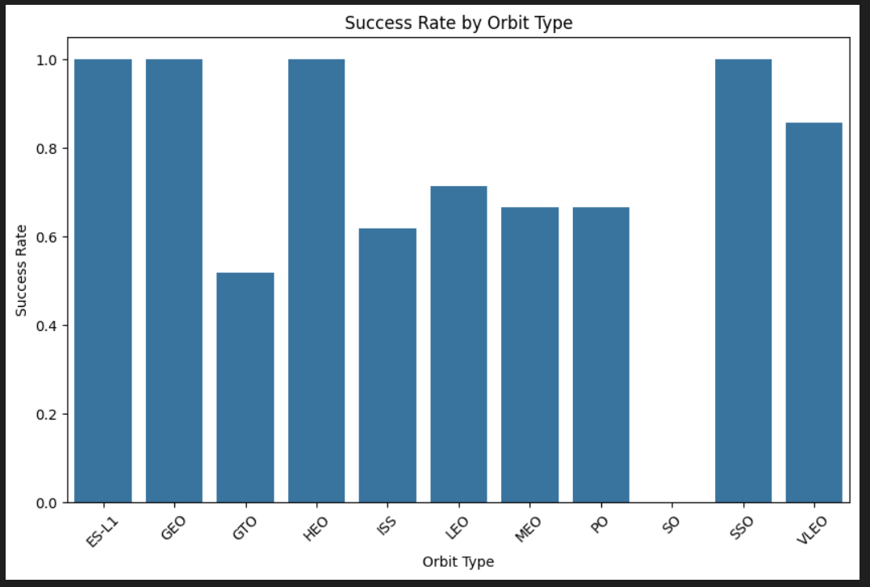
Success Rate vs. Orbit Type

Slide 18
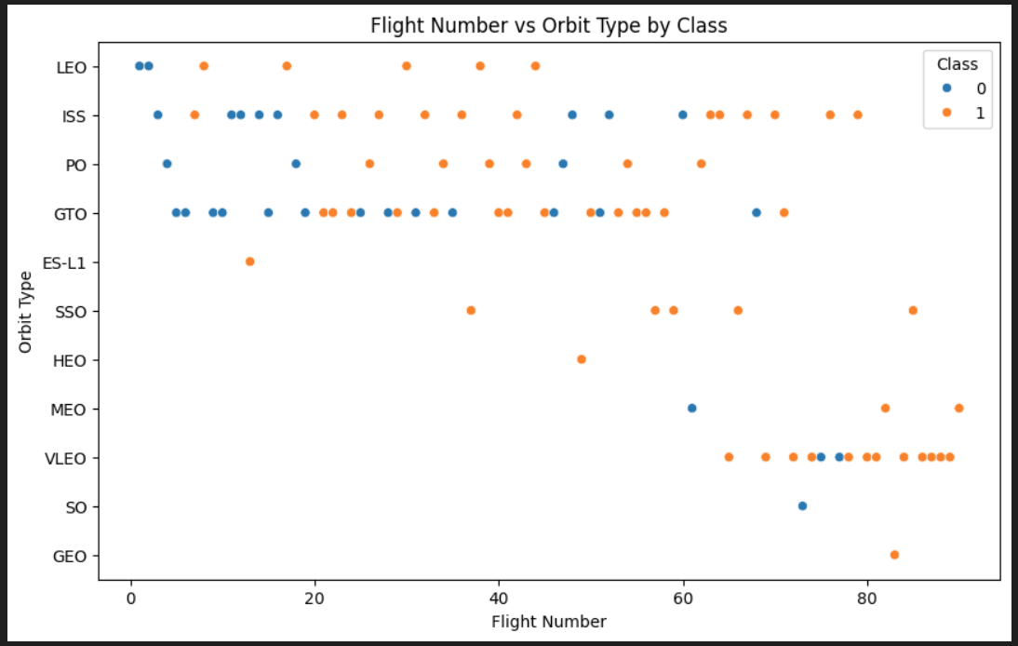
Flight Number vs. Orbit Type

Slide 19
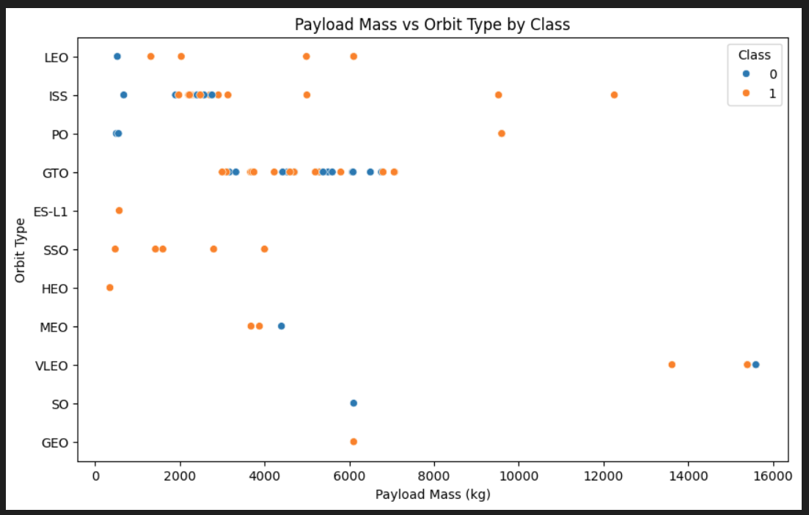
Payload vs. Orbit Type

Slide 20
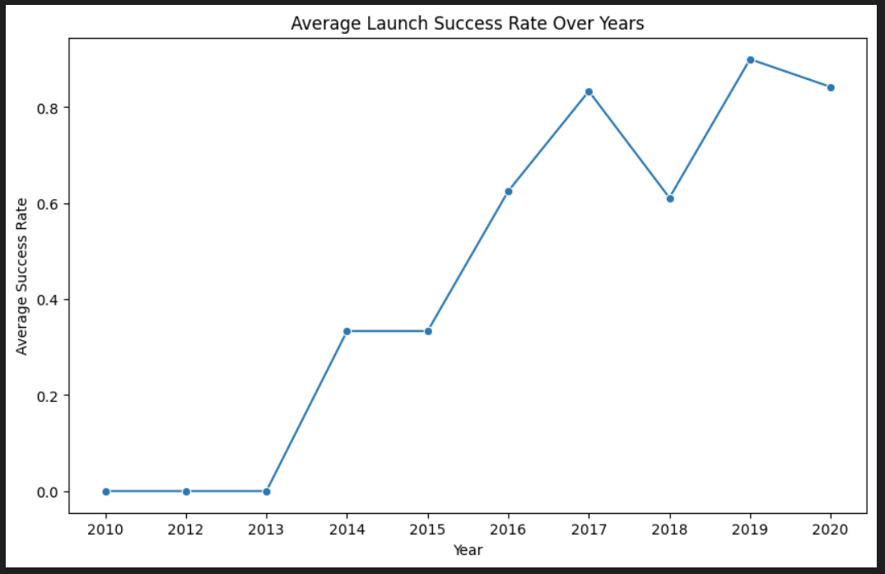
Launch Success Yearly Trend

Slide 21
All Launch Site Names
CCAFS LC-40
VAFB SLC-4E
KSC LC-39A
CCAFS SLC-40

Slide 22
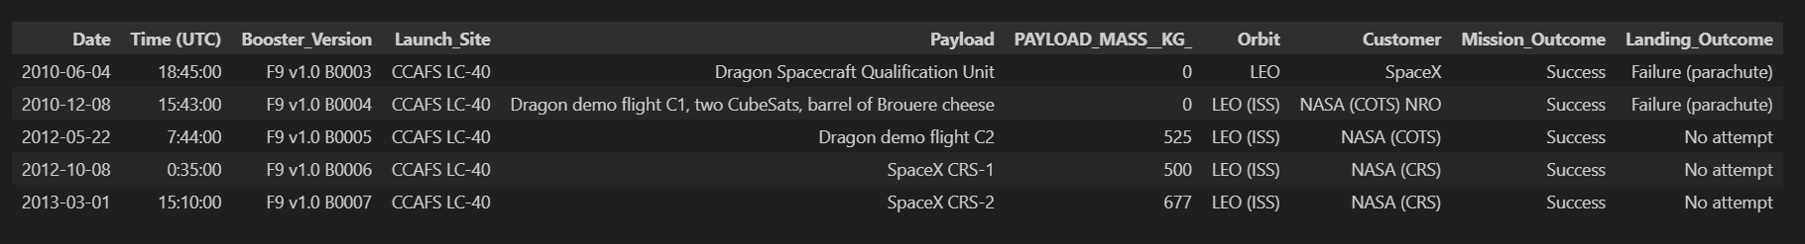
Launch Site Names Begin with 'CCA'

Slide 23
Total Payload Mass
SUM(PAYLOAD_MASS__KG_): 107 010

Slide 24
Average Payload Mass by F9 v1.1
AVG(PAYLOAD_MASS__KG_): 2 928.4

Slide 25
First Successful Ground Landing Date
min(Date): 2018-07-22

Slide 26
Successful Drone Ship Landing with Payload between 4000 and 6000
Booster_Version:
F9 B5 B1046.2
F9 B5 B1047.2
F9 B5 B1048.3
F9 B5 B1051.2
F9 B5B1060.1
F9 B5 B1058.2
F9 B5B1062.1

Slide 27
Total Number of Successful and Failure Mission Outcomes
Failure (in flight): 1
Success: 98
Success: 1
Success (payload status unclear): 1

Slide 28
Boosters Carried Maximum Payload
Booster_Version:
F9 B5 B1048.4
F9 B5 B1049.4
F9 B5 B1051.3
F9 B5 B1056.4
F9 B5 B1048.5
F9 B5 B1051.4
F9 B5 B1049.5
F9 B5 B1060.2
F9 B5 B1058.3
F9 B5 B1051.6
F9 B5 B1060.3
F9 B5 B1049.7

Slide 29
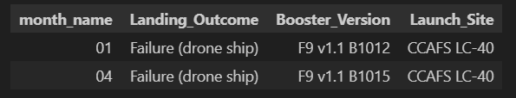
2015 Launch Records

Slide 30
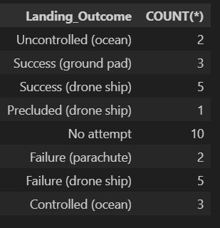
Rank Landing Outcomes Between 2010-06-04 and 2017-03-20

Slide 31

Section 3

Slide 32
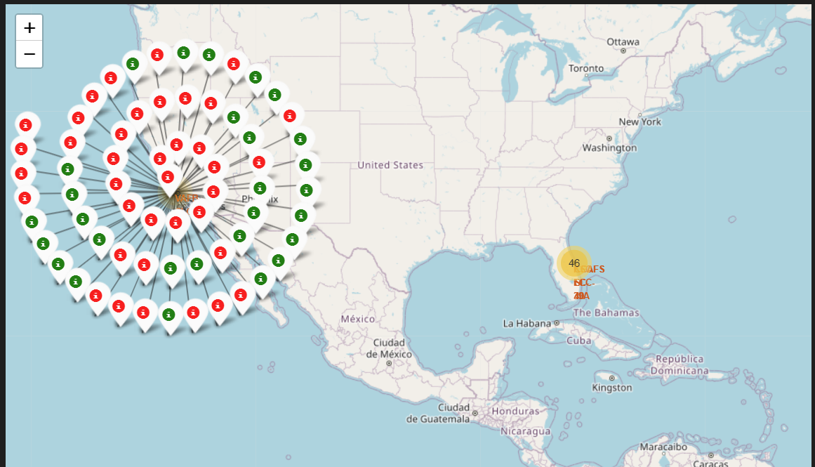
Launch Records

Slide 33
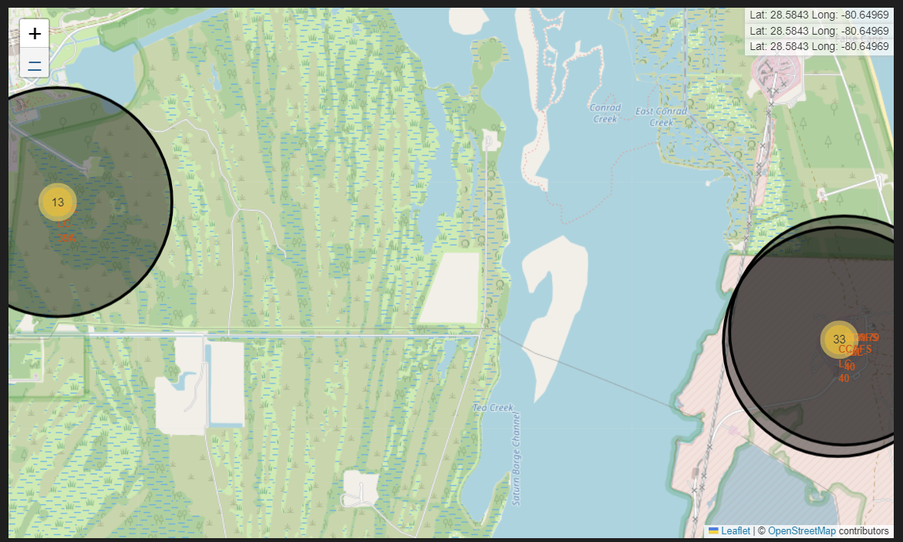
<Folium Map Screenshot 2>

Slide 34

Section 4

Slide 35
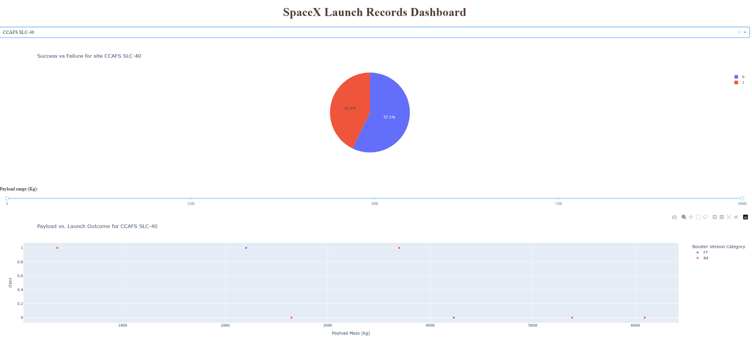
Launch Records Dashboard

Slide 36

Section 5

Slide 37
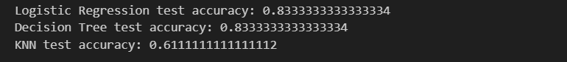
Classification Accuracy

Slide 38
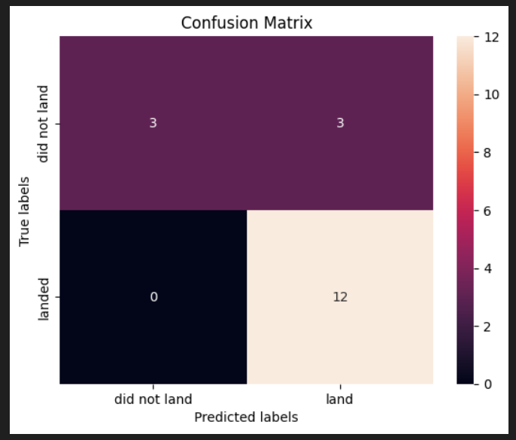
Confusion Matrix

Slide 39


